Slide 1

Project Team Presentation
Sales Performance Report
of Luxury Brand
Team 20: Pradeepti Dokka, Hunjoo Lee

Slide 2


Team 20 Introduction
Pradeepti Dokka
Hunjoo Lee

Slide 3
Agenda
Objectives
Scenario
Report Overview
ERD
Report (SQL query and Output)
Report Summary
Key Learnings
Challenges
Recommendation
Conclusion

Slide 4
Objectives
The continuous growth in sales of luxury brands despite the long-term economic downturn and pandemic situation
Understand how luxury brands
Are able to perform well in the market by making huge profits
Are able to survive in this competitive retail market
Carry their brand legacy well by maintaining their image

Slide 5
Scenario
Client:
BAPM, A luxury fashion e-commerce company
Request:
Analyze client’s database to understand its sales performance and customer characteristics
Share the findings and insight via report
Purpose:
Launch a new marketing campaign based on the report

Slide 6
Report Overview
Top 5 countries (Spending)
The highest single-order sales per year
Annual, Quarterly Sales of the year 2022
The most/least sold product
Customers who have yet to place an order

Slide 7
Main Source of Data
Revenue of the LVMH Group worldwide from 2008 to 2022, by geographic region: https://www.statista.com/statistics/410638/lvmh-group-revenue-worldwide-by-geographic-region/
LVMH Financial indicators: https://www.lvmh.com/investors/profile/financial-indicators/#groupe
The Annual Report on the Most Valuable and Strongest Luxury & Premium Brands Ranking: https://brandirectory.com/rankings/luxury-and-premium/table

Slide 8
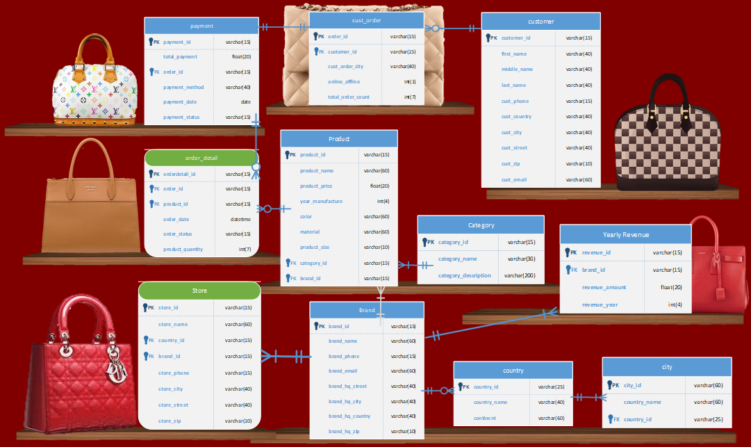

Slide 9
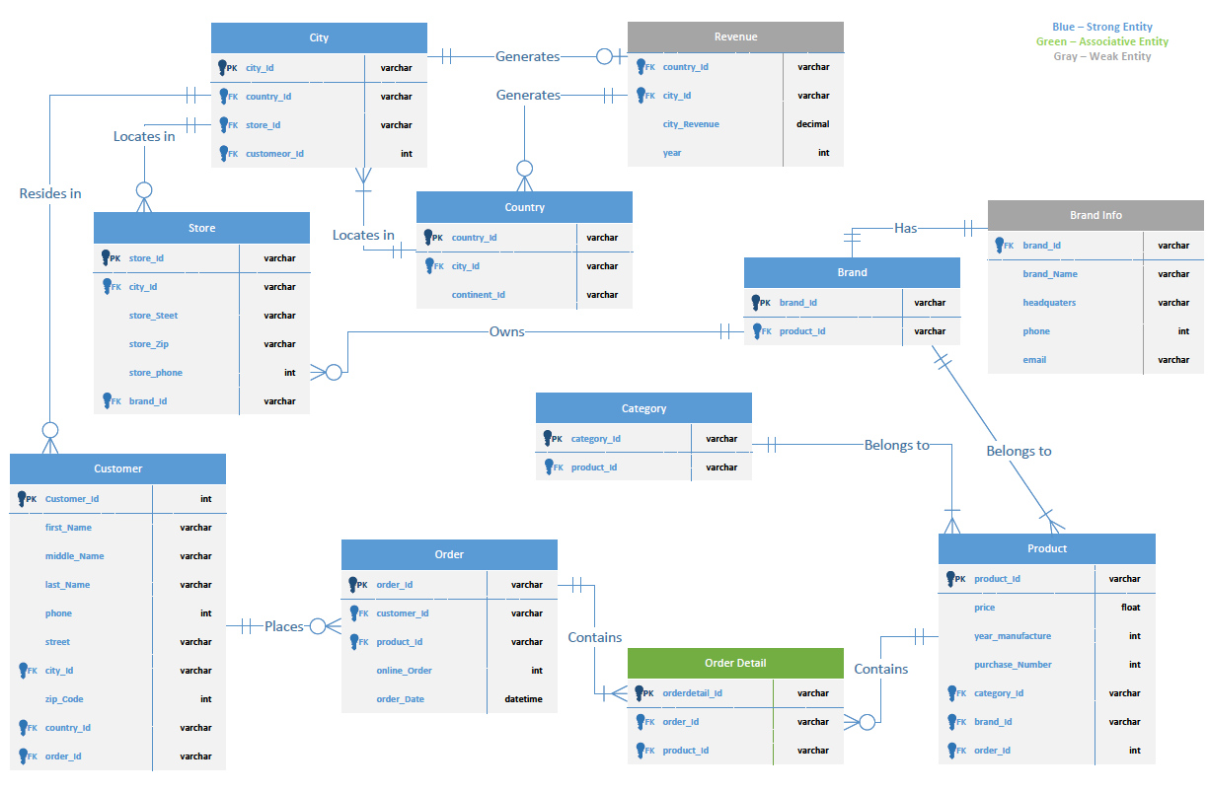
ERD (1st iteration)

Slide 10
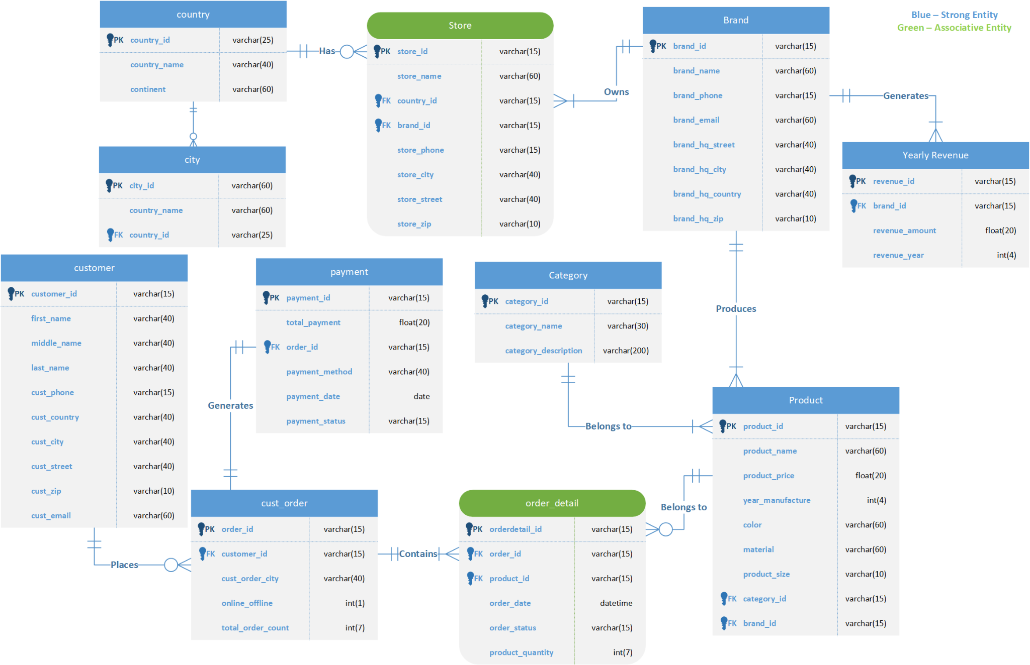
ERD (Final)

Slide 11
Reports

Slide 12
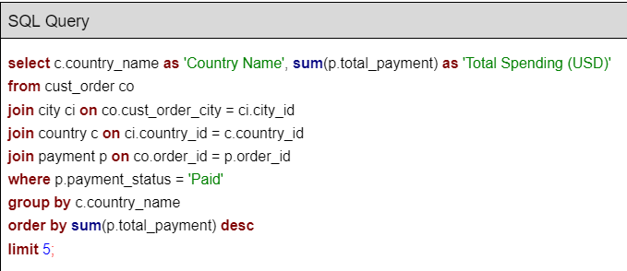
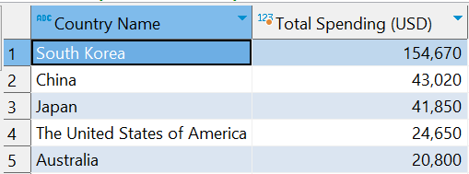
Report 1: Top 5 countries (Spending)

Slide 13
Report 1: Top 5 countries (Spending)
South Korea is the country with the highest recorded spending followed by China, Japan, USA and Australia.
Understand spending behavior of customers in different regions.
Identify high-value markets for luxury brands.
Which region to improve product offerings or adjust pricing strategies to remain competitive in the markets.

Slide 14
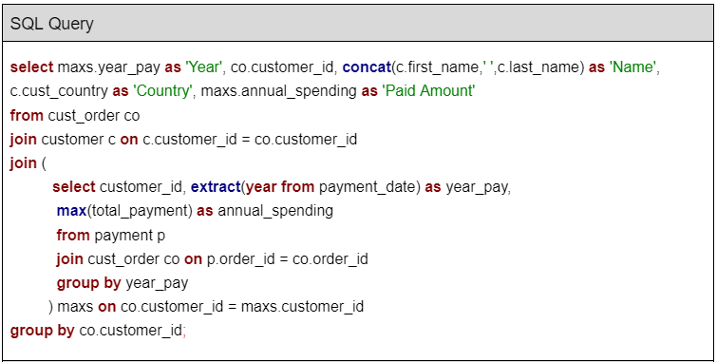
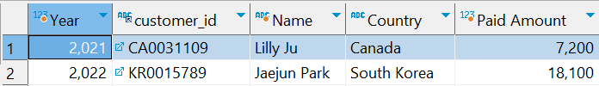
Report 2: The highest single-order sales per year

Slide 15
Report 2: The highest single-order sales per year
2021: USD 7,200 / 2022: USD 18,100
The highest single-order sale increased by 251% in one year
The company is growing and successfully attracting high-value customers
Develop targeted marketing campaigns or offering personalized promotions to big whales, as a retention strategy

Slide 16
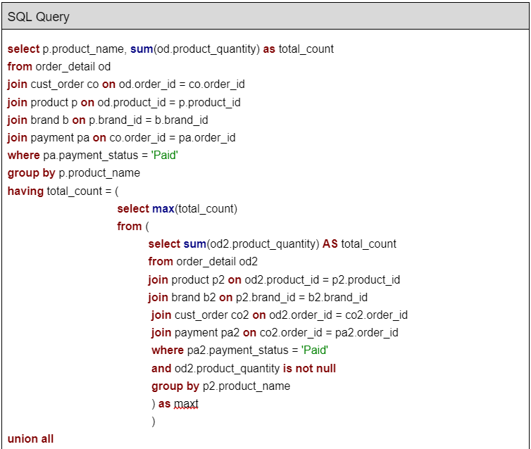
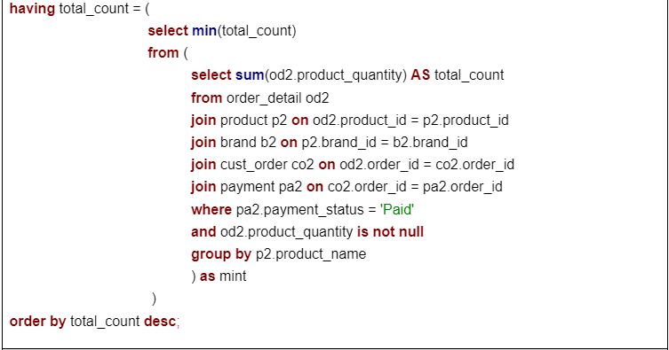
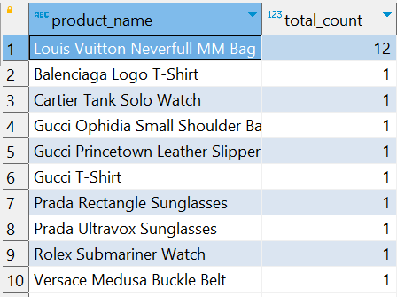
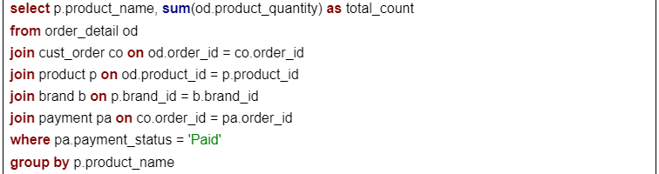
Report 4: The most/least sold product (1)

Slide 17
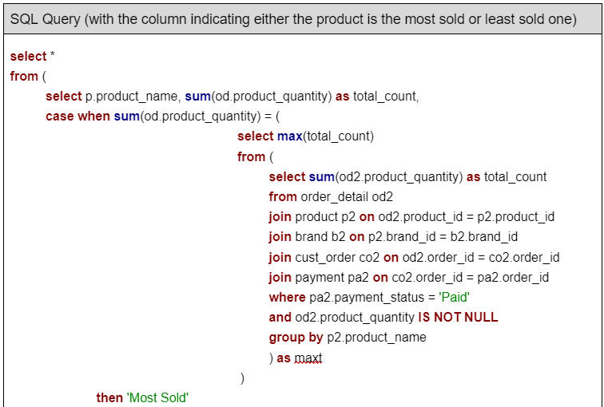
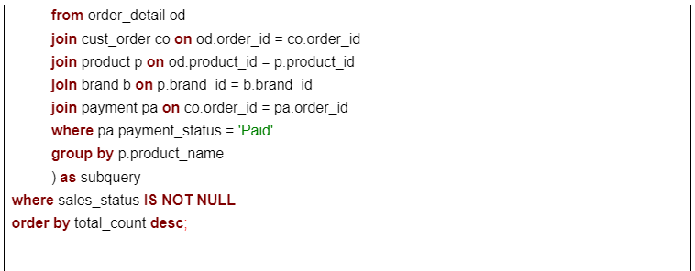
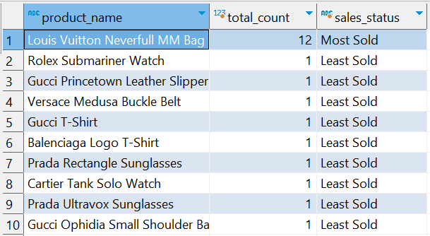
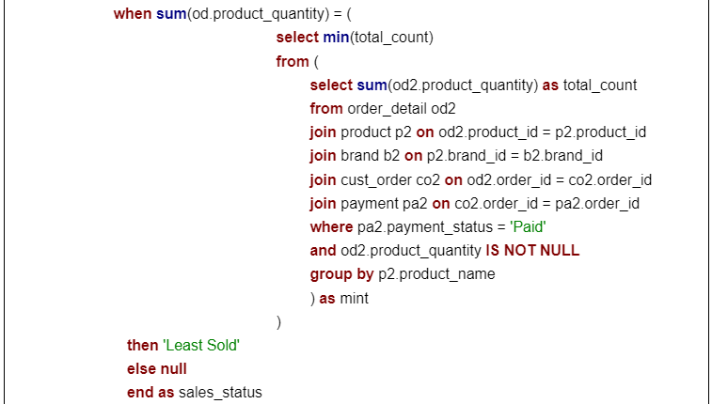
Report 4: The most/least sold product (2)

Slide 18
Report 4: The most/least sold product
Louis Vuitton Neverfull MM Bag was the most sold product
The least sold items were either small leather goods or accessories
Different strategy:
The most sold item: make sure enough stock available
The least sold item: consider discontinuation or adjust the price to appeal to customers better
Identify product in high demand and warrant further attention for marketing

Slide 19
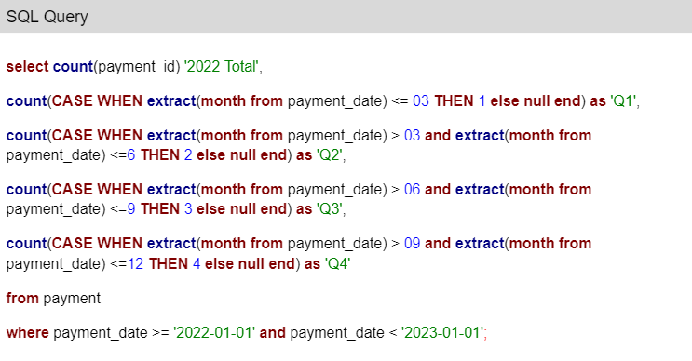

Report 3: Annual, Quarterly Sales of the year 2022

Slide 20
Report 3: Annual, Quarterly Sales of the year 2022
2022 Total:82, Q1:7, Q2:13, Q3:22, Q4:40
Peak Season strategy: focus on increasing marketing efforts during this period to maximize their sales
Low Season Strategy: implement special promotions or targeted sale to find a new and undiscovered opportunity

Slide 21
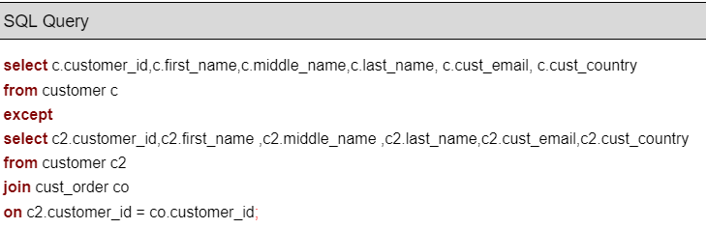
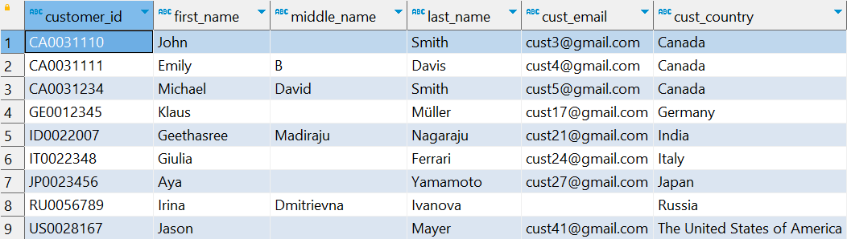
Report 5: Customers who have yet to place an order

Slide 22
Report 5: Customers who have yet to place an order
Identify any potential issues or barriers preventing these customers from making a purchase
Encourage them to make their first purchase with special offers or personal promotions
Scrutinize trends or patterns of these customers such as geographic location or demographic characteristics

Slide 23
Report Summary
Asian countries were dominant in terms of spending on luxury brands
Successful in attracting high-value customers over the years
Come up with a new strategy for better retention and keep promoting sales of high-value customers
Performs strongly in Q4 and weakly in Q1
Decide what is more profitable: focusing on the low season to generate more sales or the peak season to maximize the opportunity
New approach to manage inventory efficiently based on the report of the most/least sold items
Come up with a new marketing strategy for non-paying customers based on further research and analysis of their characteristics

Slide 24
Key Learnings
Effective data management enables well-informed business decisions
Designing an efficient database is crucial for organizing and accessing data
Generating clear and insightful reports is one of the key objectives of data management
It helps stakeholders to comprehend and utilize data effectively
Uncovering hidden patterns and insights from data can guide decision-making and enhance business processes

Slide 25
Challenges
Struggled with joining the relationships between the entities to match our report generation
Spent lot of time thinking how we can use the limited official data available with our reports

Slide 26
Recommendation
There are a couple of entities in the ERD that are not utilized for report generation
“Store” and “yearly_revenue” entities were added at initial stage to see how much revenue each store and brand generated
Those were left unused as our focus shifted to customer-level sales
Take enough time to understand the organization and the situation before building a database

Slide 27
Conclusion
Overall, it was a valuable learning experience as we could learn practical skills which could be applied in real-world situations.

Slide 28
Appendix

Slide 29
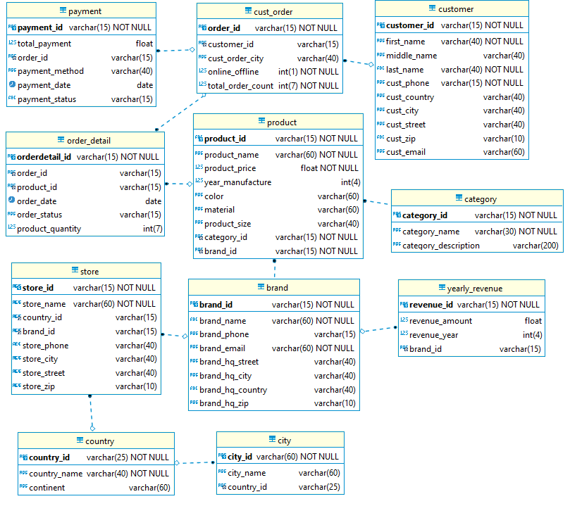
ERD (MariaDB)

